Slide 1

Timesheet Management System
By
Group :6
Gani Kalimulla
Palakala Punith Reddy
Sai Deepshika Valam
Vyshnavi Nagireddy
Swetha Sri Geda
Sathvika Reddy Battini
Guide: Prabath

Slide 2
What exactly timesheet is for?
Timesheet Contains.
Entities & Types of roles operate timesheet.
Features of the project.

Slide 3

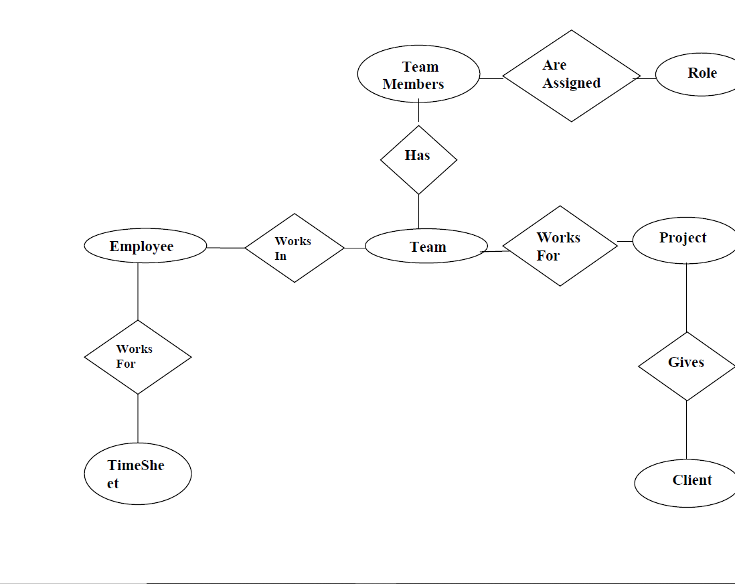
What exactly Timesheet is for?
Role
Project
Client

Slide 4

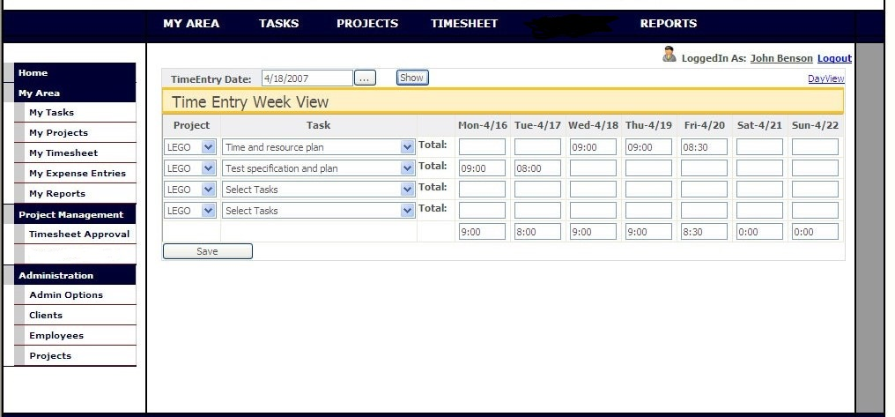
Timesheet contains

Slide 5

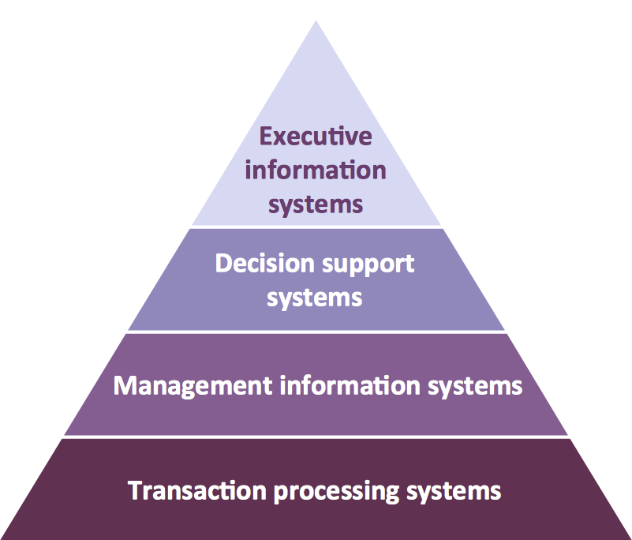
Entities & Types of roles operate timesheet
Entities
Employee
Project
Client
Timesheet
Team Roles
Types of roles operate
Administrator (Admin)
Project Master (P.M)
Project Leader (P.L)
Hr Executive (Hr)
Employee
Software Engineer
Trainee Tester
Developer
Login (User)

Slide 6
Features of the project
User friendly
One can see their details and project details.
At any time they can edit their personal details & password.
Preview the entire month project and timesheet report.

Slide 7

Thank you

